Slide 1
MATH SUBJECT FOR HIGH SCHOOL
Computer Vision
Quadratic Functions
Sudoku Solver

Slide 2
TABLE OF CONTENTS
01
02
03
04
05
06
簡介
資料來源
訓練模型
數獨前處理
數獨預測
數獨運算

Slide 3
01
簡介

Slide 4
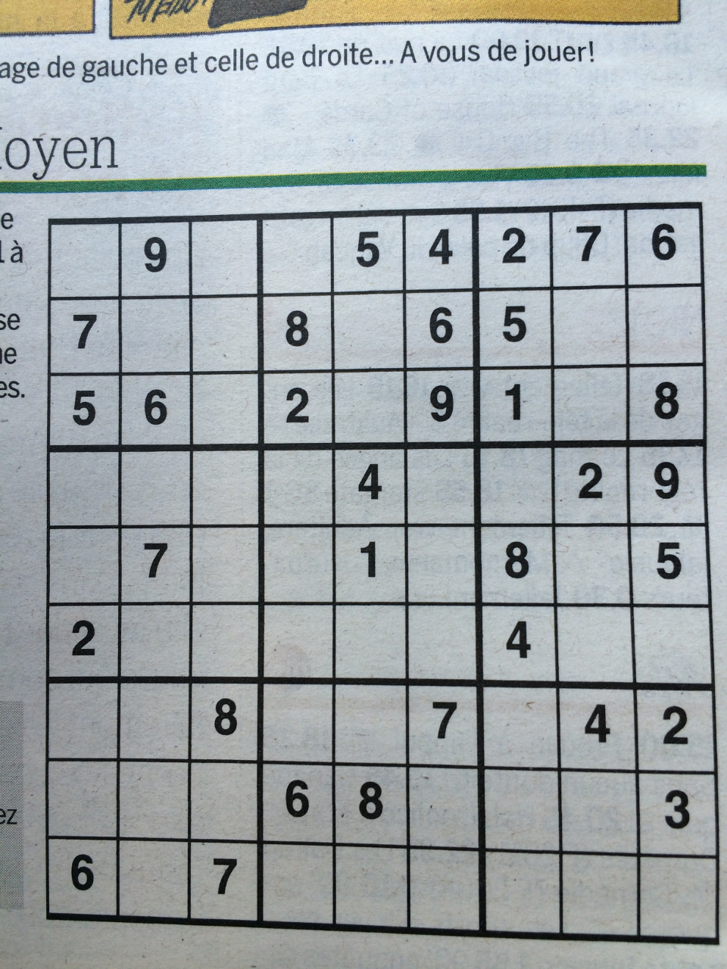
INTRODUCTION
8 | 9 | 3 | 1 | 5 | 4 | 2 | 7 | 6
7 | 2 | 1 | 8 | 3 | 6 | 5 | 9 | 4
5 | 6 | 4 | 2 | 7 | 9 | 1 | 3 | 8
1 | 8 | 6 | 7 | 4 | 5 | 3 | 2 | 9
4 | 7 | 9 | 3 | 1 | 2 | 8 | 6 | 5
2 | 3 | 5 | 9 | 6 | 8 | 4 | 1 | 2
3 | 1 | 8 | 5 | 9 | 7 | 6 | 4 | 2
9 | 4 | 2 | 6 | 8 | 1 | 7 | 5 | 3
6 | 5 | 7 | 4 | 2 | 3 | 9 | 8 | 1

Slide 5
02
資料來源

Slide 6
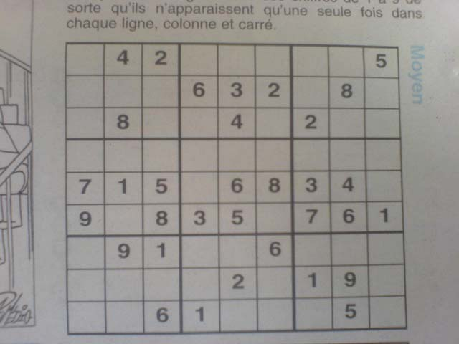
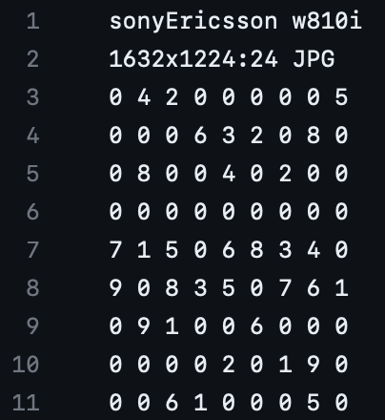
RESOURCE
203 jpg檔、203 dat檔
https://github.com/wichtounet/sudoku_dataset/tree/master/images

Slide 7
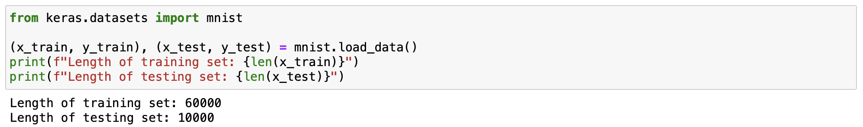
TRAINING DATA

Slide 8
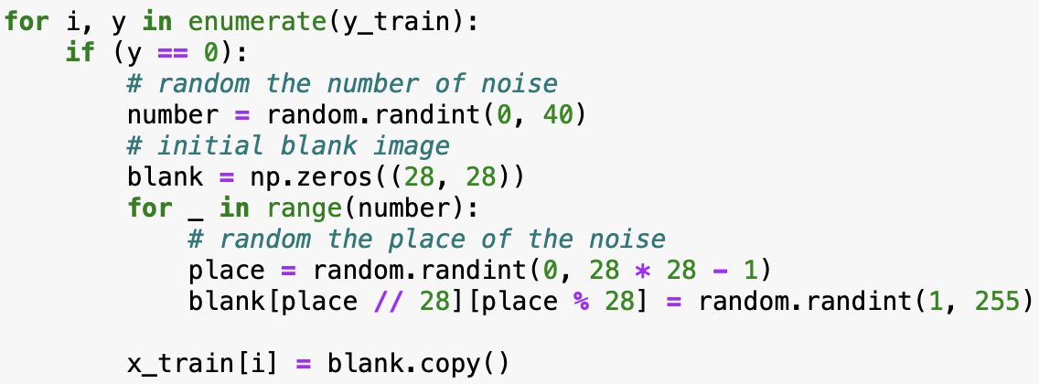
TRAINING DATA

Slide 9
03
訓練模型

Slide 10
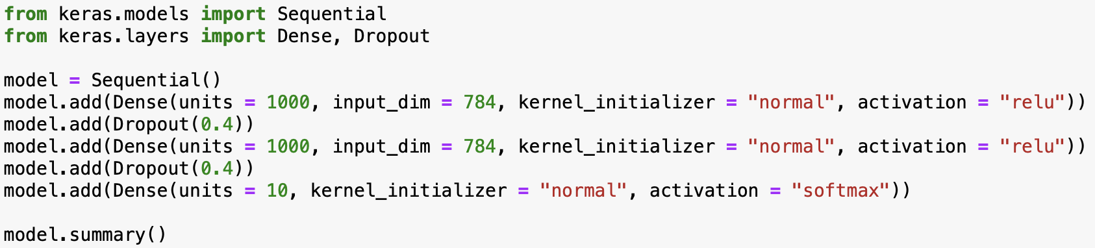

Training Model

Slide 11
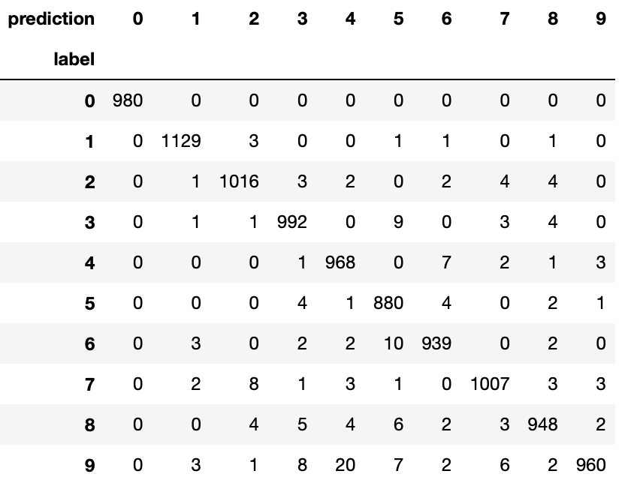
Accuracy: 98.19%

Slide 12
04
數獨前處理

Slide 13
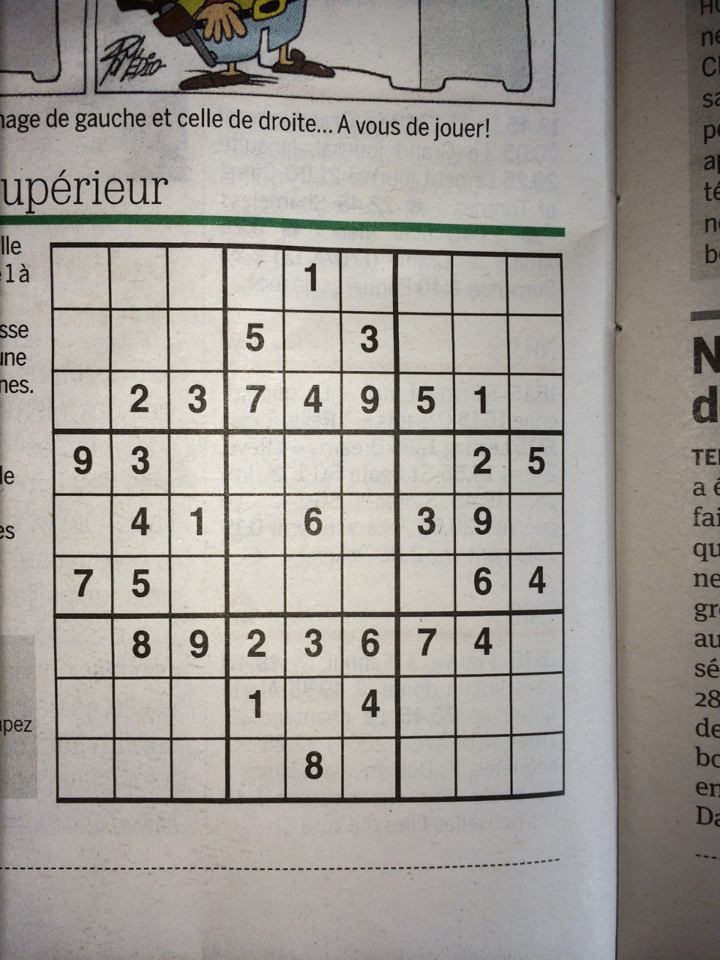
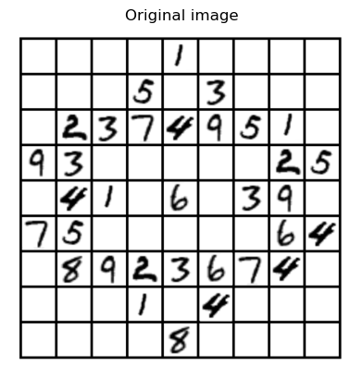

Slide 14

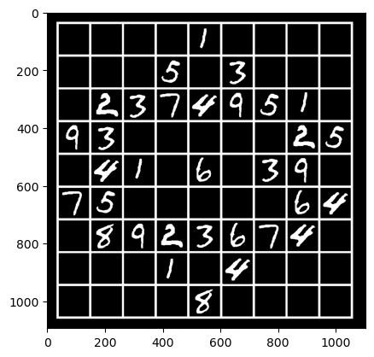

Slide 15
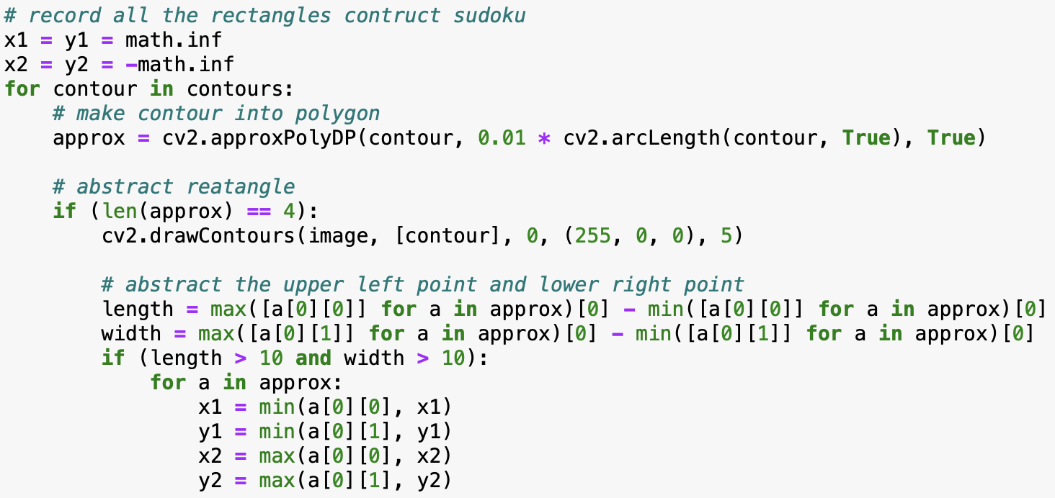

Slide 16
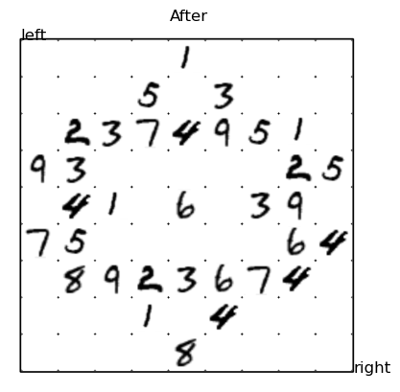

Slide 17
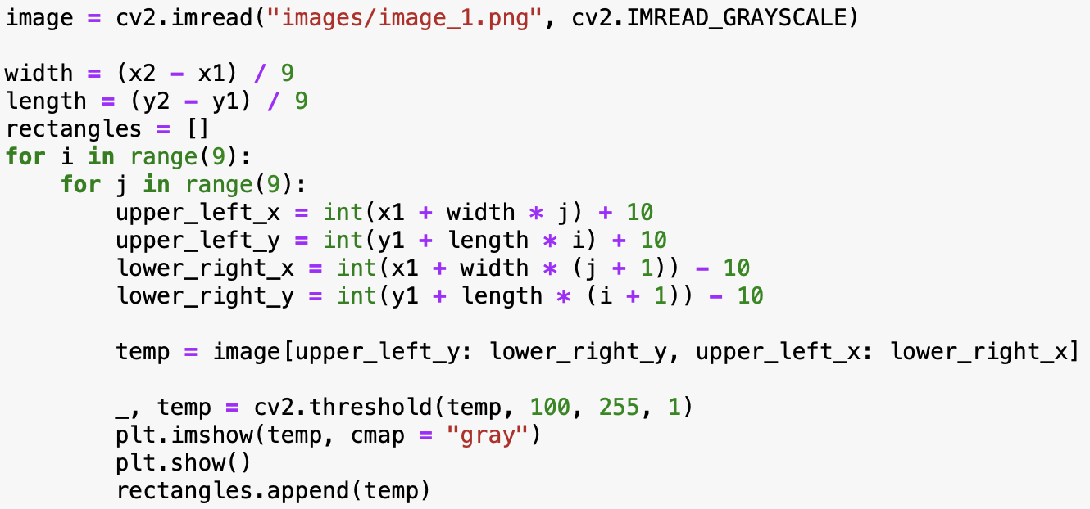

Slide 18
05
數獨預測

Slide 19
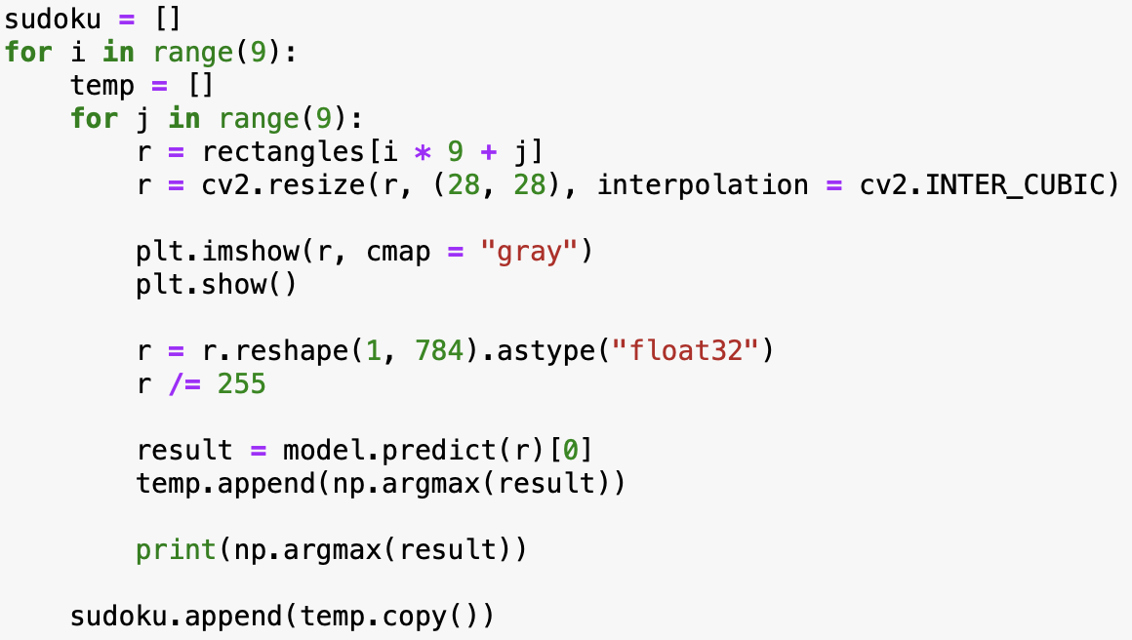

Slide 20

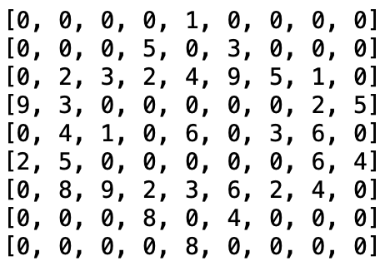

Slide 21
03
數獨運算

Slide 22
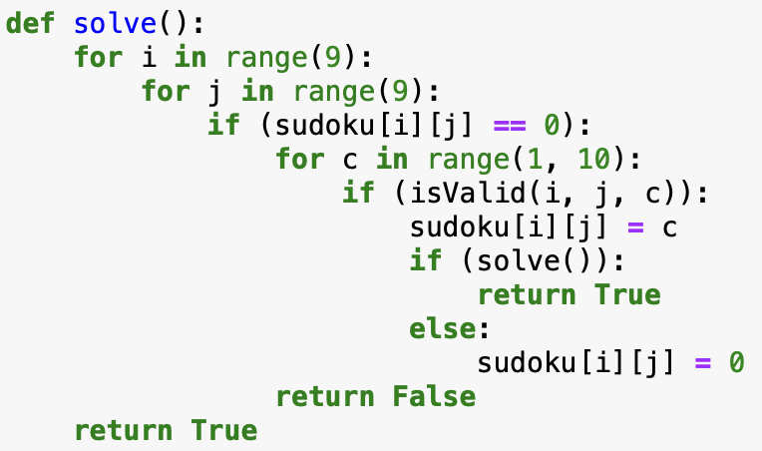
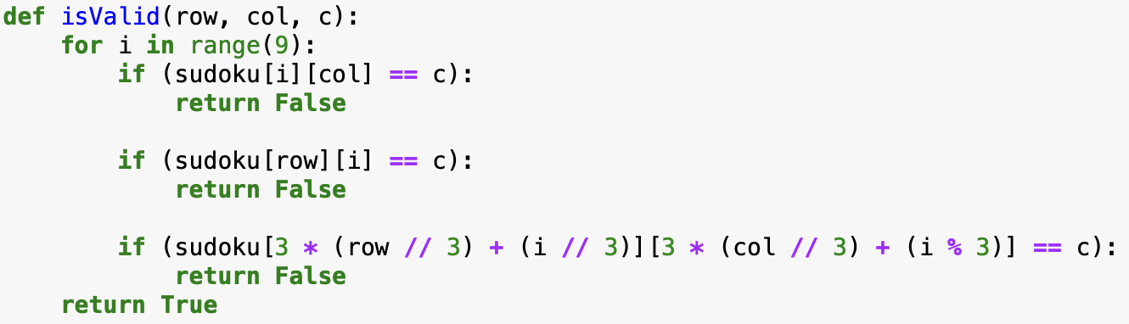

Slide 23
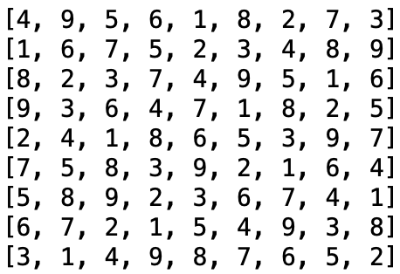

Slide 24
THANKS

